Slide 1
Intermediate Java
ETSU Department of Computing
Brianna Martinson

Slide 2

What is Java?
Java is a object-oriented programming language.
It is a great place to learn programming concepts for other languages
A simpler C++
Uses classes
Has GUI capabilities
Has plenty of libraries to use

Slide 3
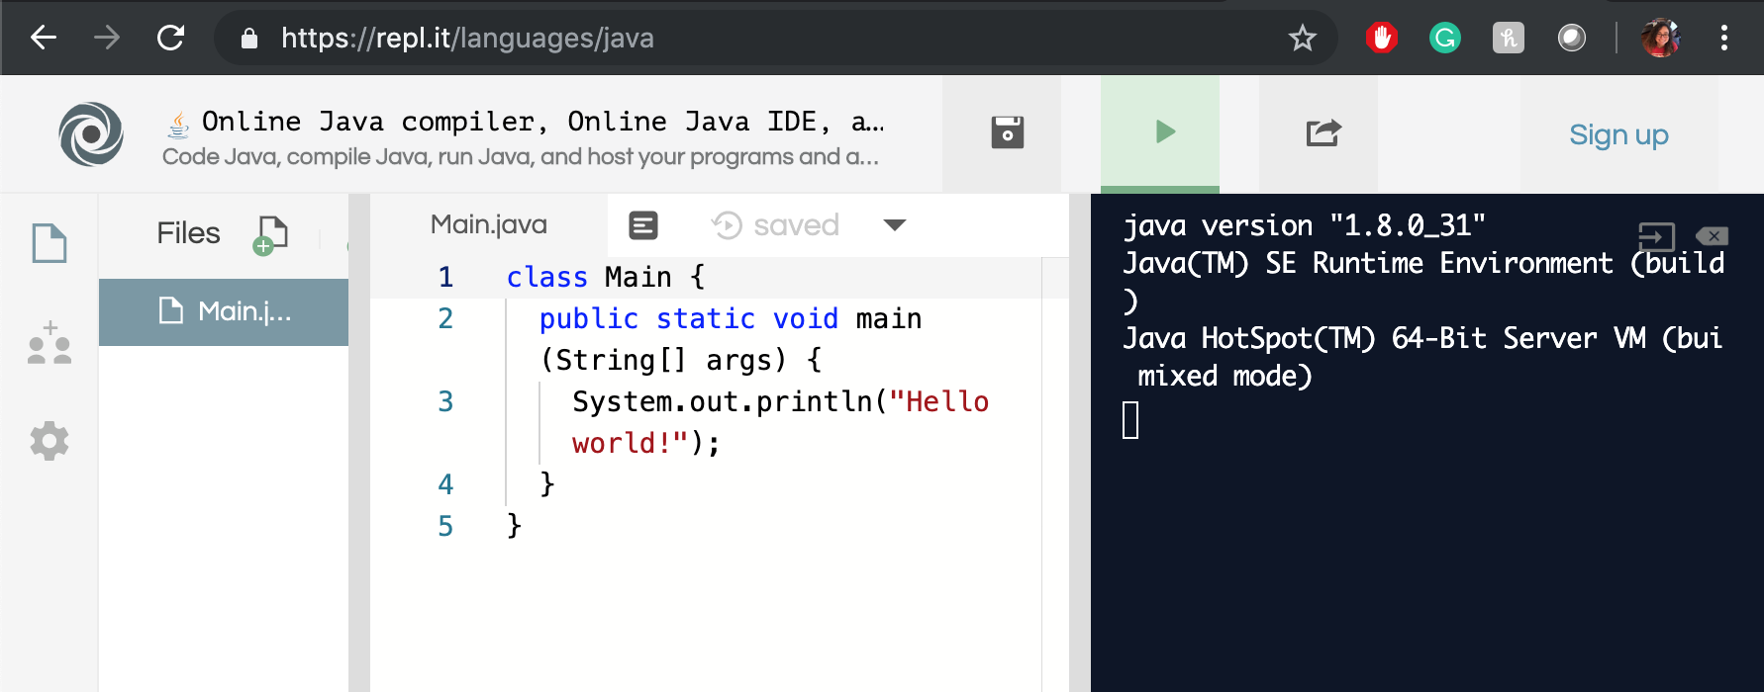
Java Editor
https://repl.it/languages/java

Slide 4
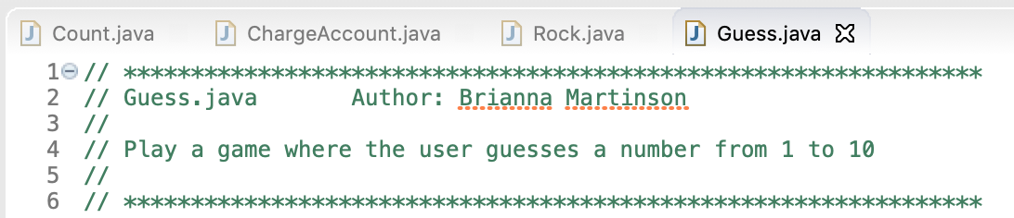
Number Guessing Game

Slide 5
Variables
Code uses variables to do calculations. Variables are containers for storing data values.
String - stores text, like "Hello World"
int - stores integers (whole numbers), like 123 or -123
float - stores a decimal, like 19.99 or -19.99
char - stores single characters, like 'a' or 'B'
boolean - stores a state: true or false
What variables would be needed in a number guessing game?

Slide 6
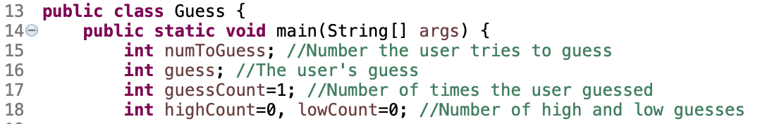
Variables
This game will need some integers:

Slide 7
User Input
For our user to be able to play the game, they have to be able to interact with it.
The premade Java library Scanner needs to be used:
The library: import java.util.Scanner;
The actual object: Scanner scan = new Scanner (System.in);
Getting input: System.out.print(“Guess the number from 1 to 10: “);
guess = scan.nextInt( );
Close scanner: scan.close( );

Slide 8
Logic Gates
How to check to see if the user guessed the number right or not:
if ( statement is true )
{
Code that runs if it is true;
}
else
{
Code that runs if it is false;
}
Compare Operators:
Equal: ==
Not Equal: !=
Greater than: >
Greater than or equal to: >=
Less than: <
Less than or equal to: <=
These always result in a boolean, either true or false.

Slide 9
Random Number Generator
To make the game difficult and different every time, it needs to be random.
Java has another library to help with this:
import java.util.Random;
Random generator = new Random( );
numToGuess = generator.nextInt(11) + 1;

Slide 10
Repetition/Iteration
Right now, the game only allows the user one guess. To repeat code we use different types of loops.
for ( int i = 0; i <= 5; i++)
{
Code repeats till i <=5 is true;
}
For loops are good for when we know how many times we want something repeated and while loops are for when it will be repeated an unknown amount.
while ( i <= 5 )
{
Code repeats till i <=5 is false;
}

Slide 11
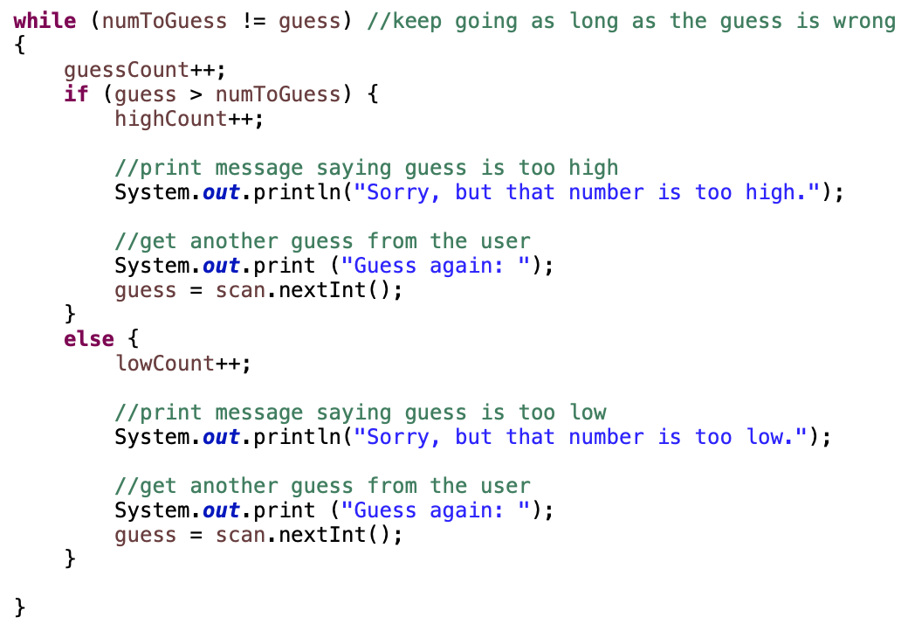
Game While Loop
Repeats until the user guesses right.
When they guess wrong it will allow them to guess again.
Also keeps track of the total amount of times they have guessed and how many times they guess too high and too low.
Be careful of infinite loops, make sure there is a way out of the loop. In the game, it is when we keep asking for input because eventually they will guess right.

Slide 12
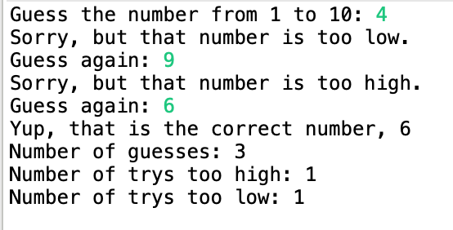
Putting it together
Once they do guess correctly, use System.out.println( ); to tell them and let them know how many guesses they had.
After that, after some debugging, the game should be playable.

Slide 13
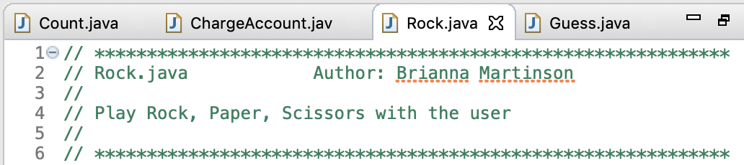
Rock, Paper, Scissors

Slide 14
Planning out the Code
For this game what will we need?
What variables are needed?
Will we need any Java libraries?
How is the user interacting with the game?
How do they win/lose?
What happens when they win/lose?
What type of logic flow will the code follow?
Think about loops and logic gates.

Slide 15
Variables and Imports
Need a mix of String variables and an Integer variable to determine the computer’s move:
String personPlay, computerPlay;
int computerInt;
Also need a Scanner, for user input, and a Random, for the computer player, object:
personPlay = scan.nextLine( );
computerInt = generator.nextInt(3);

Slide 16
Bad User Input
Usually the user does not know EXACTLY what we, the coder, is looking for. Bad input can break your code, so we need to fool-proof it.
scan.nextLine( ); takes in any input and converts it to a string which is convenient but also means they can type in anything. We are only looking for “(R for rock, S for scissors, P for paper)”.
Control case sensitive:
str = str.toUpperCase( );
str = str.toLowerCase( );
str1.compareTo( str2 );
str1.compareToIgnoreCase( str2 );

Slide 17
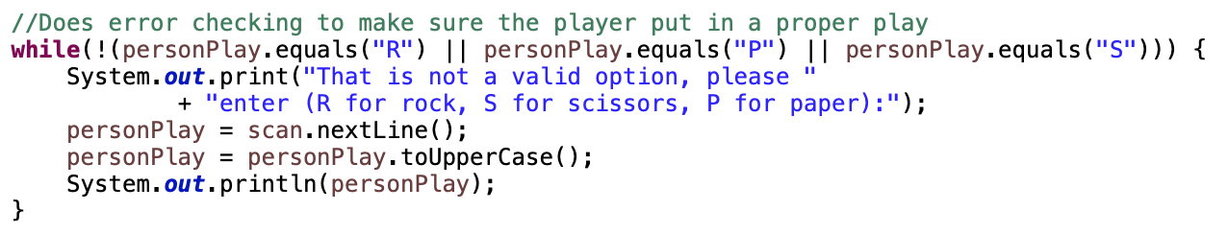
Bad User Input
Keep asking them for input until they understand and give proper input so the program does not crash:

Slide 18
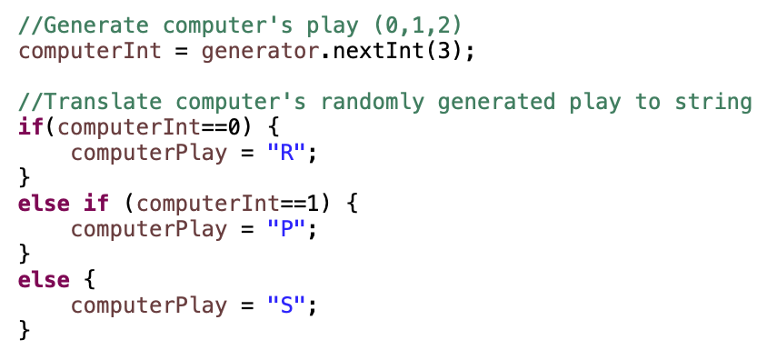
The Computer Player
Next, translate the random number the computer was assigned to a logical part of the game (Rock, Paper, or Scissors)
Once that is converted, now the computer’s and player’s choice can be compared
Rock crushes scissors
Paper covers rock
Scissors cut paper
When input is the same, it is a tie

Slide 19
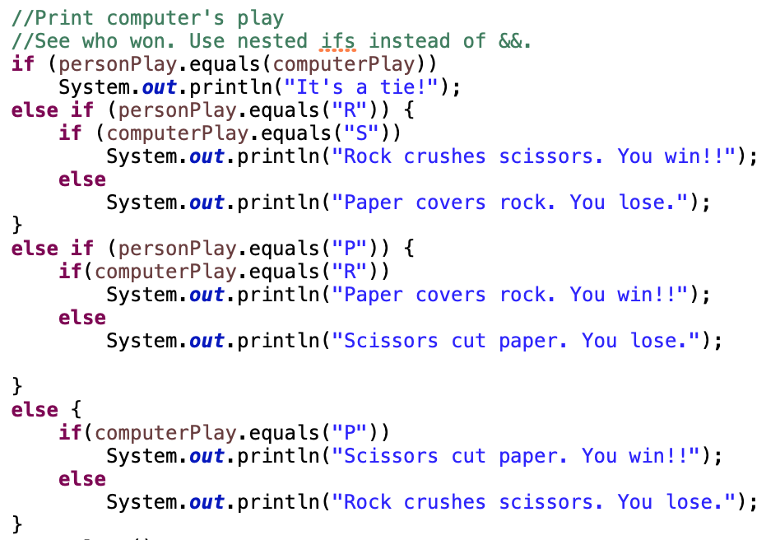

Slide 20
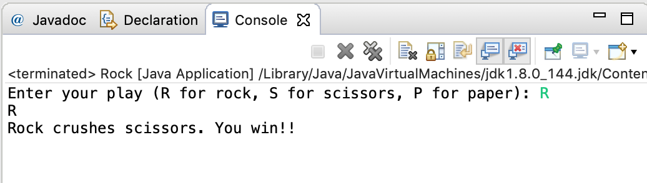
Put it Together
Run through your code and debug. Once all your errors are fixed (syntax/coding errors and logical errors) play your game!

Slide 21
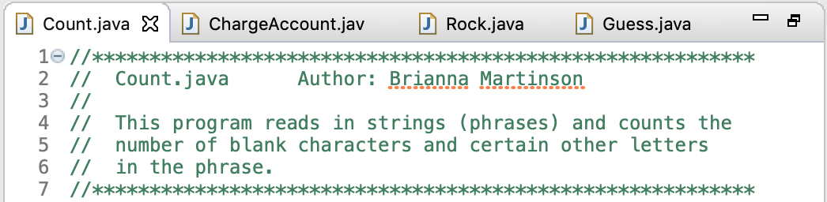
Character Counter

Slide 22
Planning out the Code
For this game what will we need?
What variables are needed?
Will we need any Java libraries?
How is the user interacting with the program?
How many sentences can they enter?
What type of logic flow will the code follow?
Think about loops and logic gates.

Slide 23
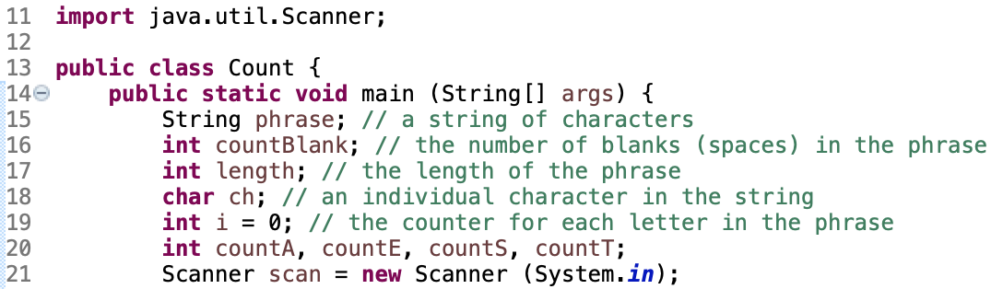
Variables and Imports
We will need Strings, integers, and characters:

Slide 24
Picking Apart the String
Remember to check and fool-proof the user’s string (does capitalization matter)
A word is a collection of letters, in code it is the same. A string is an array of chars:
str = “Hello World”; // In code, for place values you start counting at 0
chr = str.charAt( 1 ); // So chr would be e
length = str.length( ); // length(); finds how many char are in the string: 11

Slide 25
Looping through the String
We want to loop through each character of the string. With the length( ); function, we know exactly how many characters that would be. Knowing that, we can use a for loop.
// Remember for place values, start counting at zero.
for ( int i = 0; i < length; i++)
{
Code that iterates till i reaches the last char of the string;
}

Slide 26
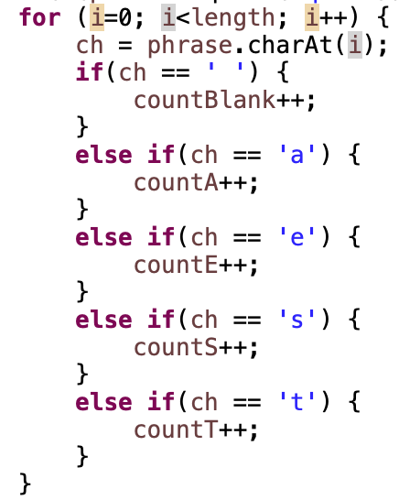
Gathering Data
This for loop finds all the a, e, s, and t letters in the phrase. Notice for char use ‘single quotes’ instead of “double quotes” like strings.
The user probably wants to type in more than just one sentence, so we can put this whole for loop in a while loop.
while( !(phrase.equals(“quit”)))
{
Code that repeats till the user types “quit”;
}

Slide 27
Nested Loops
When code has a loop within a loop, that is called a nested loop. Nested loops are very helpful because code usually does not execute in one exact way every time.
But remember be careful of infinite loops especially when the code’s logic starts to get more complicated.
Remember to keep asking the user for a new phrase so they can enter “quit” when they are done using the program.

Slide 28
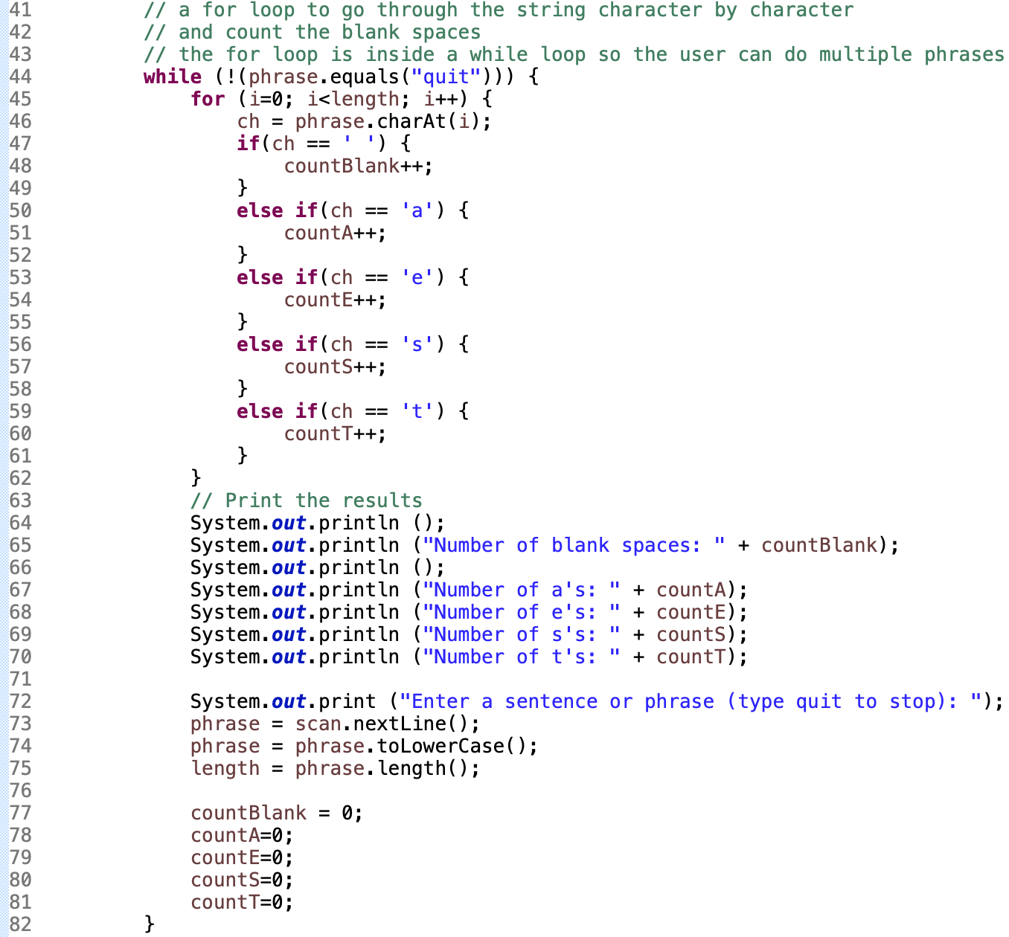

Slide 29
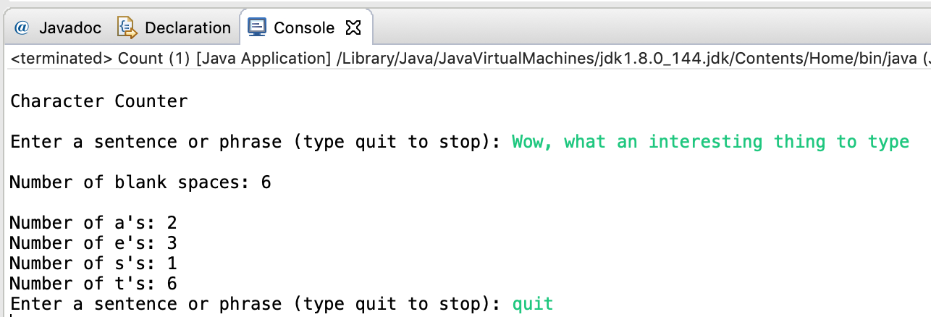
Putting it Together
Run through your code and debug. Once all your errors are fixed (syntax/coding errors and logical errors) test out your program!

Slide 30
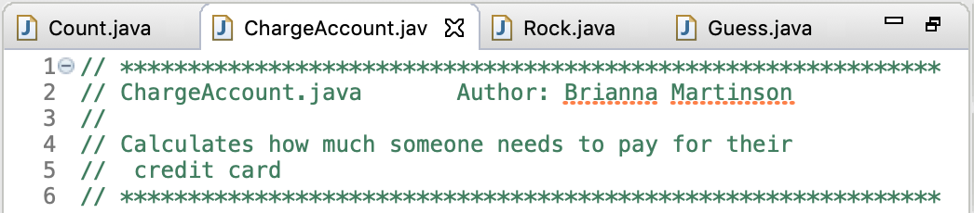
Card Statement

Slide 31
Planning out the Code
For this game what will we need?
What variables are needed?
Will we need any Java libraries?
How is the user interacting with the program?
How many sentences can they enter?
What type of logic flow will the code follow?
Think about loops and logic gates.

Slide 32
Variables and Imports
We will be working with numbers, more particularly doubles since we will have decimals:
double prevBalance, charges, interest, newBalance, payment;
Since we have user input, we need the Scanner.
Money has a specific format: $20.35
Luckly, Java has a library for that already:
import java.text.NumberFormat;
NumberFormat money = NumberFormat.getCurrenceyInstance( );
money.format( 20.35 ); // prints $20.35

Slide 33
User Input
To calculate the user’s statement, we need to know their previous balance and how much they are charged for using the card.
Remember to make sure the user’s input is valid and makes sense in the context:
scan.nextDouble( ); //Takes in a double value from the user

Slide 34
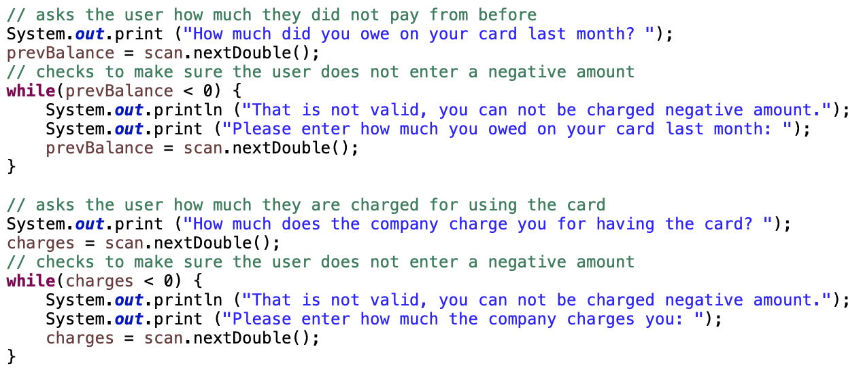

Slide 35
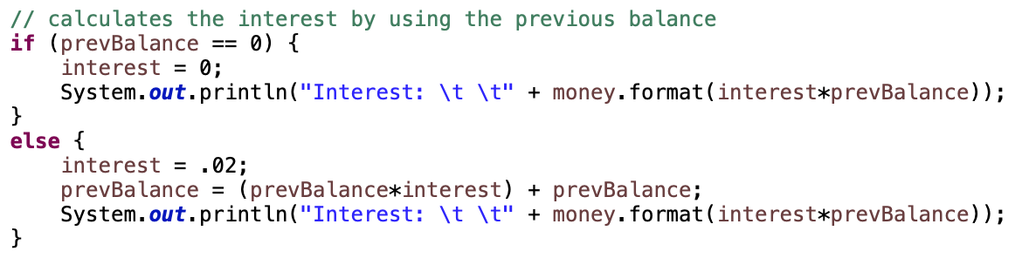
Calculations
With the previous balance and additional charges, now we can calculate the interest:

Slide 36
Calculations continued
Now Calculate the new balance:
If the new balance is less than 50 then the new balance is left alone.
If the new balance is less than or equal to 50 and less than or equal to 300 than the new balance gets set to 50.
If the new balance is greater than 300 then the new balance gets an additional 2% charge.

Slide 37
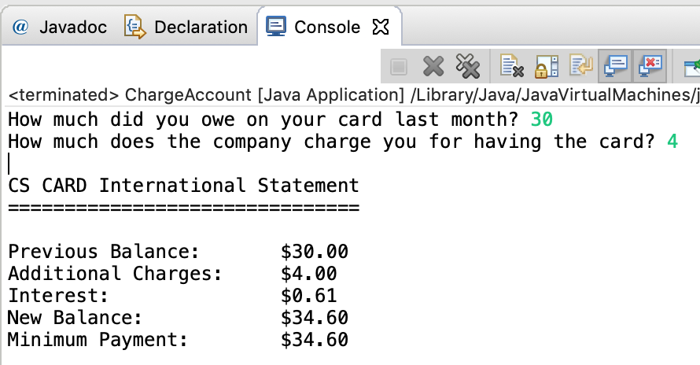
Put it Together
Run through your code and debug. Once all your errors are fixed (syntax/coding errors and logical errors) test out your program!

